Slide 1
Mobile Project
NoteKeeper

Slide 2
Our application
Cross-platform To-Do application where users can easily save tasks and notes with simple UI

Slide 3
Goals
Get experience in mobile development
Learn Full-stack (MERN) development
Make a Cross-platform mobile application
Get involved with JavaScript, especially React Native

Slide 4
Main features
Authentication (login/out, register)
JWT, Bcrypt
Add, delete, edit notecards or taskcards
Manage taskcards
Checklist
Notifications
Local notifications

Slide 5
Technologies
MongoDB
Data storage
Express.js
Building our RestAPI
React Native
Frontend
Node.js
Running our server-side JavaScript code

Slide 6
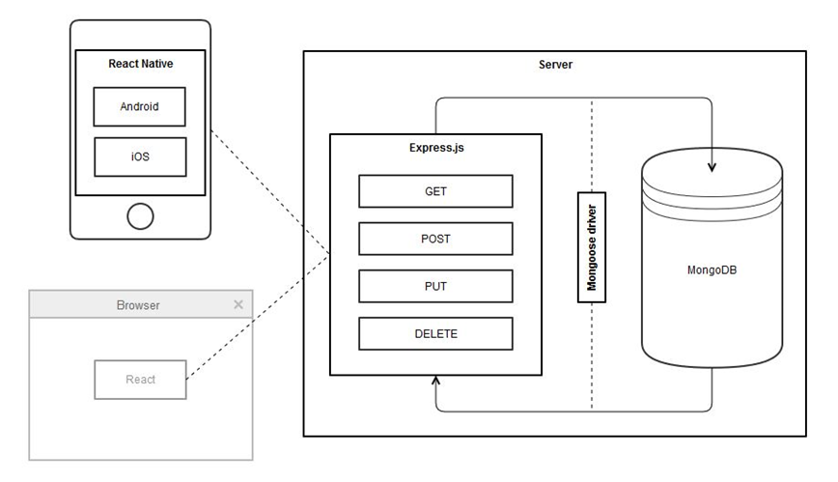
Application architecture

Slide 7
Problems
UI
Building UI for both platforms to look native was problematic
Application doesnt look ”native”, more like ”Hybrid”
Regular working schedule
Multiple courses with bigger projects

Slide 8
How to improve/expand
Better API route optimization
Error handling
Give more information to users when an error occurs
Improved UI and better feedback for user actions
Unique UI, give up on ”native” look
Bugs!!
Users can share their workspace with other user or create groups
Desktop application which can utilize the same backend
Better scheduling and doing project more regularly

